Slide 1



New Credit Card Fraud Detection System
Natasha Bhatt
Surbhi Lakhera
Utkarsh

Slide 2
Contents
Objective
Introduction
Methodology
Key Insights
Cost Benefit Analysis
Appendix:
Data Attributes
Data Methodology
Attached Files

Slide 3
Objective
Getting in place a credit card fraud detection system to save on incurred costs incurred
Huge costs are being incurred due to frauds and a manual detection system

Slide 4
Introduction
Credit card fraud is a major concern in the financial world, with billions of dollars lost every year. As the use of credit cards for online transactions increases, so do the opportunities for fraudsters.
Machine learning (ML) has emerged as a powerful tool for combating credit card fraud. Here's a basic overview of how it works:
Data is Key
Training the Model
Identifying Red Flags
Real-Time Advantage

Slide 6
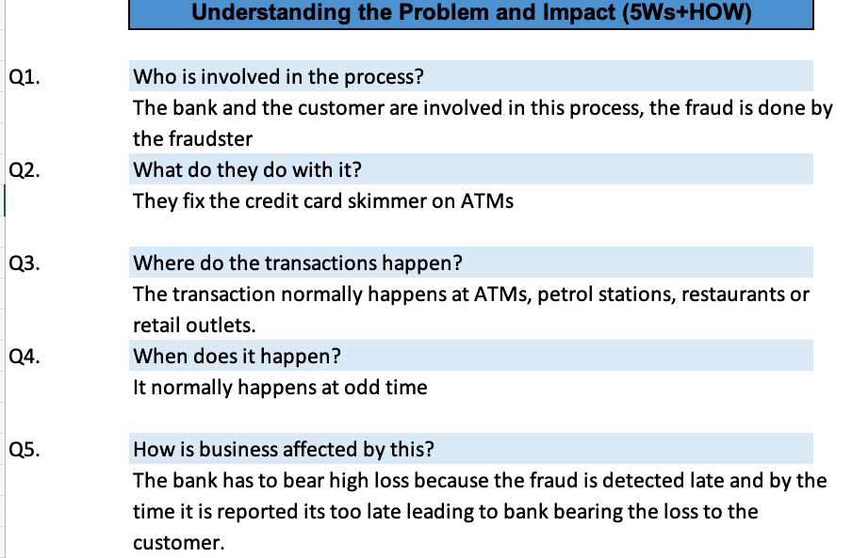

Slide 7
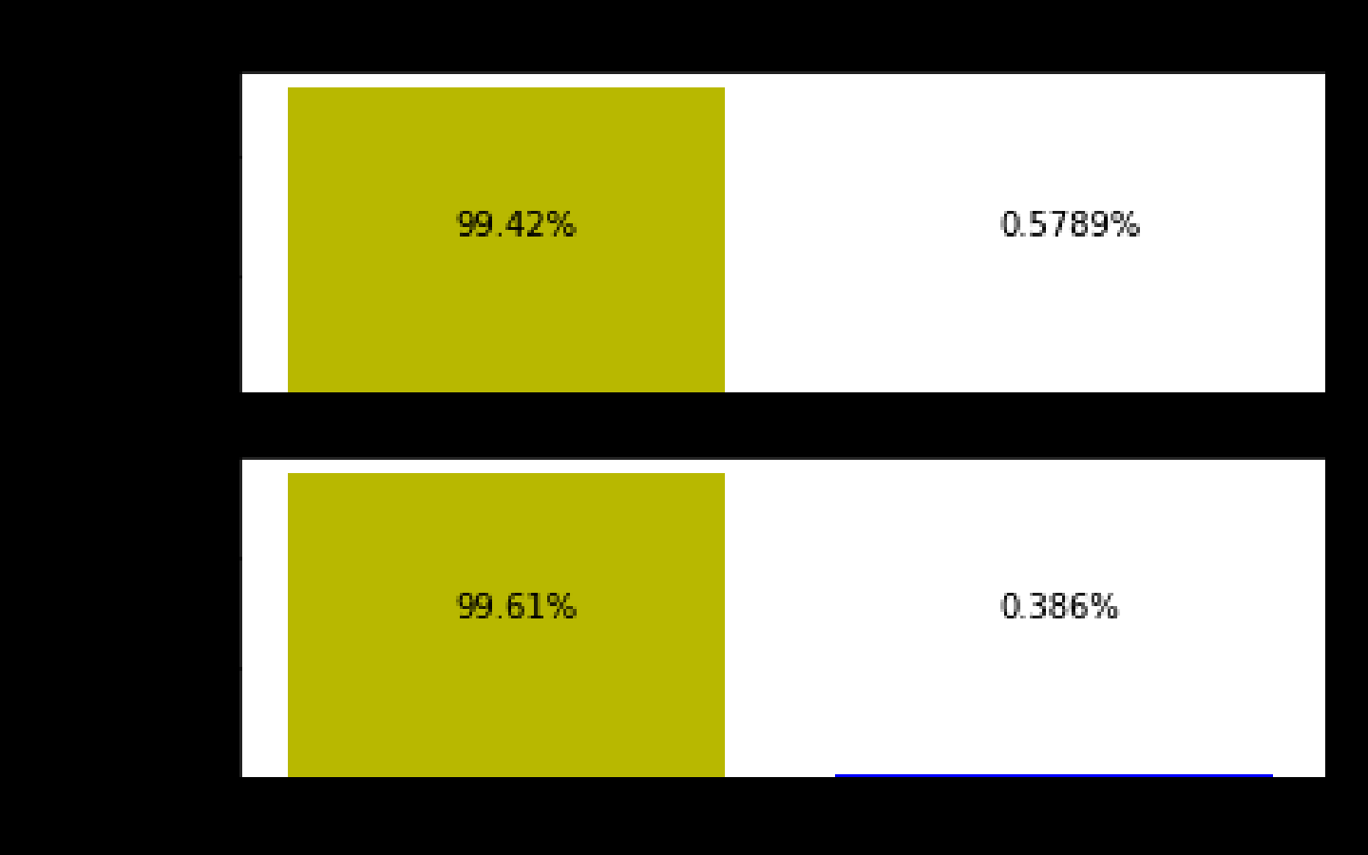
Methodology
Loaded the test & train data then dropped unnamed column
Converted date column to datetime format
Dropped unnecessary fields for model building
Checking for class imbalance
Creating age field on transaction date & finding distance from customer location to merchant location in latitude & longitude
Checking for highly skewed categorical variable and binary mapping on gender
Creating dummy variable for category and dropping state

Slide 8
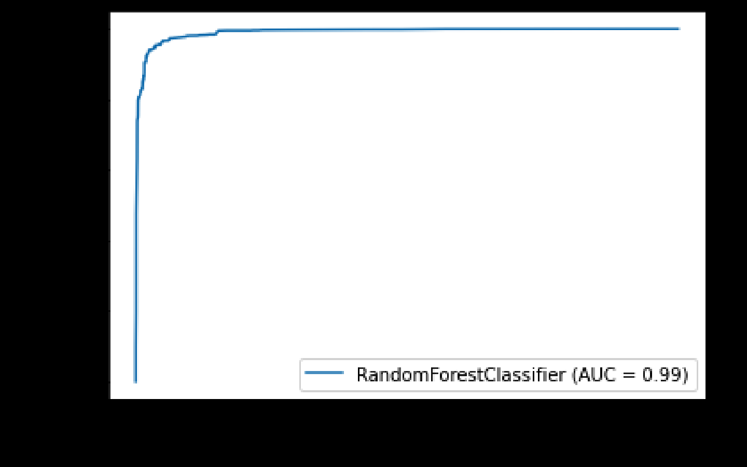
Methodology
Oversampling data using ADASYN to compensate high class imbalance in data
Building random forest model, ROC curve for train data
Predicting on test set and then testing model on original data without oversampling(Accuracy=.98)
Merging train and test dataset for cost benefit analysis

Slide 9
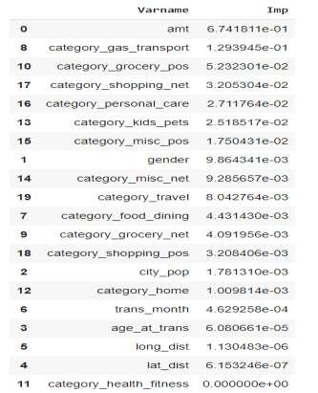
Key Insights
Transaction amount, category and gender are the most important variables
Gas and transport, grocery and shopping are the top three categories

Slide 10
Cost Benefit Analysis

Slide 11
Current Incurred Losses
77,183 credit card transactions per month
402 fraudulent transactions per month
$ 530.66 amount per fraud transaction
Total costs incurred from fraud transactions is $ 213,392.22

Slide 12
After New Model Deployment
1720 fraudulent transactions detected by the
model
$ 1.5 cost to provide customer support to
these transactions that is $ 2,580.38 in total
68 fraudulent transactions not detected by
model which amounts to $ 35,908.09 loss
Total cost incurred after new model
deployment is $ 38,488.46
Final savings after new model deployment is
$174,903.76 that is reduction in losses by ~82%

Slide 13
Appendix: Data Attributes
🞇 Snapshot of the data:
index - Unique Identifier for eac h row
transdatetrans_time - Transaction DateTime
cc _num - Credit Card Number of Customer
merc hant - Merc hant Name
c ategory - Category of Merc hant
amt - Amount of Transac tion
first - First Name of C redit Card Holder
last - Last Name of Credit Card Holder
gender- Gender of Credit Card Holder
street - Street Address of C redit Card Holder
c ity - City of C redit Card Holder
state - State of C redit Card Holder
zip - Zip of C redit Card Holder
lat - Latitude Location of C redit Card Holder
long - Longitude Location of C redit Card Holder
c ity_pop - Credit Card Holder's City Population
job - Job of Credit Card Holder
dob - Date of Birth of C redit Card Holder
trans_num - Transac tion Number
unix_time - UNIX Time of transac tion
merc h_lat - Latitude Location of Merc hant
merch_long - Longitude Location of Merchant
is_fraud - Fraud Flag <--- Target Class

Slide 14
Appendix: Data Methodology
A random forest classifier built on top a Kaggle simulated dataset
Class imbalance adjusted using Adaptive Synthetic (ADASYN) sampling method
Manual hyperparameter tuning done due to extensive computational time when using Grid Search Cross Validation

Slide 15
Attached Files
Cost Benefit Analysis:
/Users/surbhilakhera/Desktop/capstone project/Cost Benefit Analysis.xlsx
Random Forest Classifier Model:
/Users/surbhilakhera/Desktop/capstone project/CC Fraud Analytics Capstone.ipynb
Rising Fraud Issue Tree:
/Users/surbhilakhera/Desktop/capstone project/RISING_FRAUD.pdf
Structured Problem Solving:
/Users/surbhilakhera/Desktop/capstone project/Structured+Problem+Solving.xlsx

Slide 16
Business Impact
Here are some benefits of using machine learning for credit card fraud detection:
Faster and More Accurate
Adapting to Evolving Threats
Reduced Losses
However, there are also challenges to consider:
Data Quality
Imbalanced Data
False Positives
Overall, machine learning offers a powerful weapon in the fight against credit card fraud. As technology continues to develop, ML models will become even more sophisticated and effective in protecting consumers and financial institutions.

Slide 17
Thank You

